Slide 1
Unit 2: Emerging Ethical issues in Data Science

Slide 2
Syllabus
Ethical Issues in Data Visualization
Ethical Issues in Machine Learning
Ethical challenges in emerging technologies e.g., AI, IoT, biometrics, blockchain
Ethical challenges in data science research
Ethical considerations in collaborative data science environments
Ethical issues in using the internet, privacy and security, in the context of data science.

Slide 3
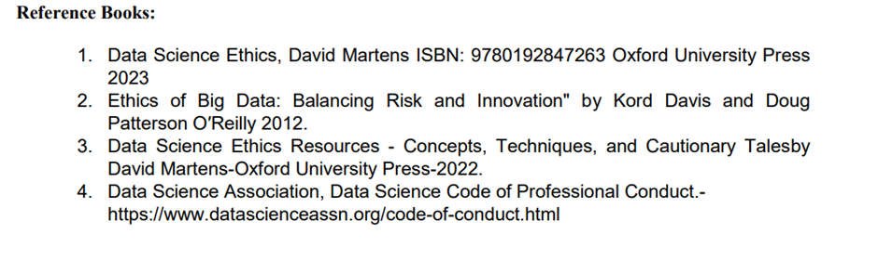

Slide 4
Ethical Issues in Data Visualization
Data visualization is a powerful tool in data science, but it also presents several ethical issues that must be addressed to ensure responsible use.
Types of Ethical Issues in Data Visualization
Misleading Visuals
Omission of Context
Data Integrity and Accuracy
Bias and Fairness
Privacy and Confidentiality
Responsibility and Accountability
Ethical Standards and Guidelines

Slide 5
Misleading Visuals
[1] Manipulation of Scale: Altering the scale of graphs to exaggerate or downplay findings can mislead viewers.
For example, truncating the y-axis to emphasize minor differences.
Example of Manipulation of Scale in Data Visualization
Consider a scenario where a company wants to present its sales performance over the past five years.
The actual sales figures are relatively stable, with only minor fluctuations year over year.
To create a more dramatic effect, the company manipulates the scale of the y-axis in their bar graph.

Slide 6
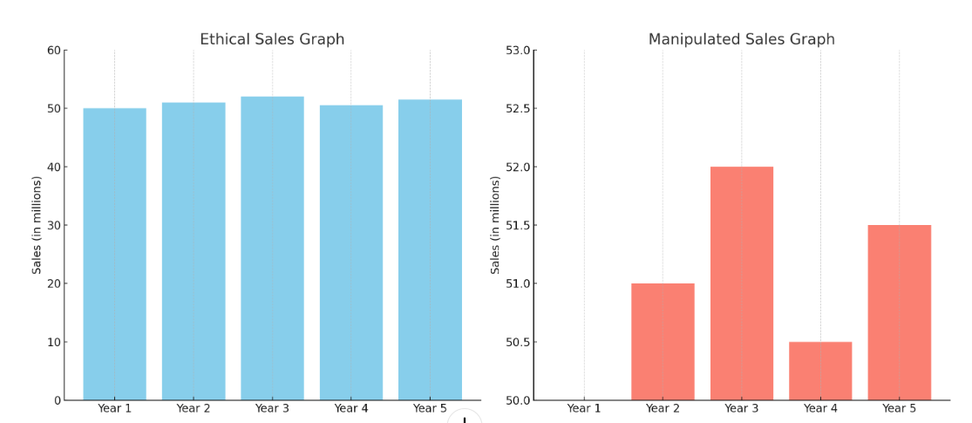
Misleading Visuals
Ethical Visualization
In an ethical visualization, the y-axis would start at zero and accurately represent the sales figures.
In the graph, the minor fluctuations in sales are correctly depicted, showing that the sales figures have been relatively stable over the five years.
Original Data (in millions):
Year 1: 50M
Year 2: 51M
Year 3: 52M
Year 4: 50.5M
Year 5: 51.5M

Slide 7
Misleading Visuals
Ethical Visualization
The y-axis starts at 0.
The sales data is represented accurately, showing minor fluctuations over the five years.
Manipulated Visualization
The y-axis starts at 50, significantly truncating the lower part of the scale.
The same sales data now appears to have dramatic changes, misleading viewers into thinking there were significant fluctuations.

Slide 8
Misleading Visuals
Impact of Scale Manipulation
This example demonstrates how altering the scale of graphs can mislead viewers by exaggerating or downplaying findings.
It's essential to maintain an appropriate scale in data visualizations to ensure that the data is represented accurately and ethically, allowing viewers to make informed decisions based on truthful information.

Slide 9
Misleading Visuals
[2] Cherry-Picking Data: Selecting specific data points or time frames that support a particular narrative while ignoring data that contradicts it.
This practice can mislead viewers by presenting an incomplete or biased picture of the data.
Example of Cherry-Picking Data in Data Visualization
Suppose a company wants to highlight an increase in customer satisfaction to support a new marketing campaign.
They have customer satisfaction data over ten years, but the overall trend is relatively flat with some fluctuations.
By cherry-picking data from only the years that show an increase, they can create a misleading visualization.

Slide 10
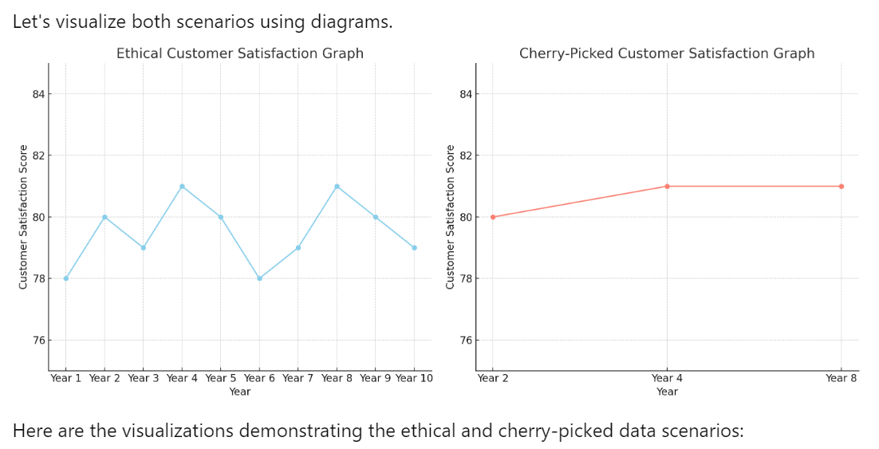
Misleading Visuals
Full Data (Customer Satisfaction Scores out of 100):
Year 1: 78
Year 2: 80
Year 3: 79
Year 4: 81
Year 5: 80
Year 6: 78
Year 7: 79
Year 8: 81
Year 9: 80
Year 10: 79
Ethical Visualization
Includes all data points from Years 1 to 10.
Shows a complete picture of customer satisfaction
Over ten years, including both increases and decreases.
The trend appears relatively stable with minor fluctuations.
Cherry-Picked Visualization
A cherry-picked visualization might only include data from Years 2, 4, and 8, where the satisfaction scores were higher, ignoring the years where the scores were lower or fluctuated.
Year 2: 80
Year 4: 81
Year 8: 81
Ethical Visualization
Cherry-Picked Visualization
Includes only selected data points from Years 2, 4, and 8.
Omits years with lower satisfaction scores or fluctuations.
Creates a misleading impression of consistently high and increasing customer satisfaction.

Slide 11
Omission of Context
[1] Lack of Context:
Presenting data without sufficient context can lead to misinterpretation.
Viewers might draw incorrect conclusions if they don't understand the broader situation or contributing factors.
[2]Insufficient Annotations:
Failing to provide necessary labels, legends, or explanations that help viewers understand the visualization.

Slide 12
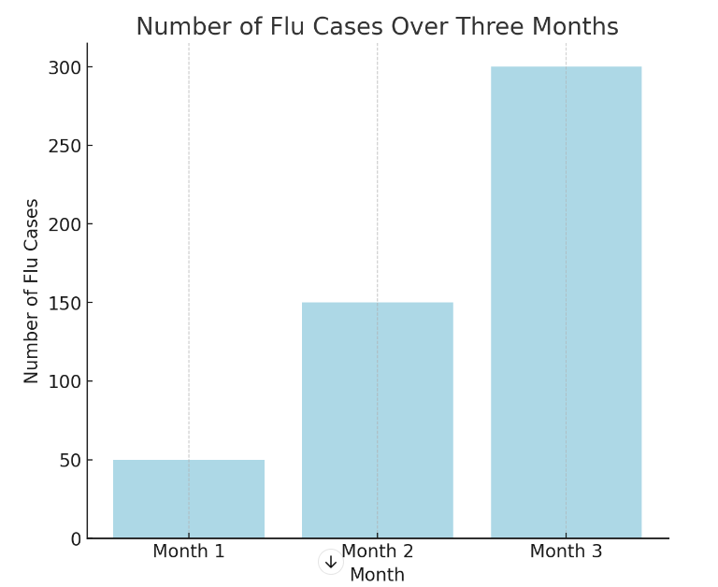
Omission of Context
Presenting data without sufficient context can lead to misinterpretation because viewers might not understand the broader situation or contributing factors.
Example of Lack of Context in Data Visualization
A health organization wants to show the number of flu cases over a three-month period to highlight a significant increase.
They present the data in a simple bar chart without providing additional context such as vaccination rates, seasonal trends, or public health interventions.
Data (Number of Flu Cases per Month):
Month 1: 50 cases
Month 2: 150 cases
Month 3: 300 cases

Slide 13
Omission of Context
Visualization With Context
To provide the additional context, here's how the data could be presented more informatively:
Current and Historical Flu Cases
Current Year: Month 1: 50 cases, Month 2: 150 cases, Month 3: 300 cases.
Previous Year: Month 1: 45 cases, Month 2: 100 cases, Month 3: 250 cases.
Vaccination Rates (Percentage of Population)
Month 1: 60%
Month 2: 55%
Month 3: 50%
Testing Rates (Number of Tests Conducted)
Month 1: 1000 tests
Month 2: 2000 tests
Month 3: 4000 tests
By providing this context, viewers can better understand that the increase in reported flu cases might be influenced by a decrease in vaccination rates and an increase in testing rates, rather than a dramatic worsening of the flu outbreak. This comprehensive approach helps to avoid misinterpretation and provides a clearer, more accurate picture of the situation

Slide 14
Omission of Context
[2] Insufficient Annotations

Slide 15
Data Integrity and Accuracy
[1] Inaccurate Representations: Using incorrect data, mislabeling axes, or misrepresenting data points can lead to false conclusions.
[2] Simplification vs. Accuracy: Oversimplifying data to make it visually appealing can sometimes strip away essential details, leading to misleading interpretations.

Slide 16
Bias and Fairness
[1] Cultural Bias: Designing visualizations that do not consider cultural differences in color perception, symbolism, or reading patterns.
[2] Algorithmic Bias: Visualizing data from biased algorithms without addressing the underlying bias can perpetuate misinformation.

Slide 17
Privacy and Confidentiality
[1] Anonymity: Visualizing data in a way that inadvertently reveals sensitive or personal information can violate privacy.
[2] Granularity: Providing too much detail in visualizations can make it possible to identify individuals in supposedly anonymized datasets.

Slide 18
Responsibility and Accountability
[1] Authorship: Taking responsibility for the visualizations created and being accountable for their impact.
[2] Feedback Mechanisms: Establishing channels for feedback and correction to address any issues or inaccuracies in the visualizations.

Slide 19
Ethical Standards and Guidelines
[1] Adherence to Guidelines: Following ethical guidelines and best practices established by professional organizations, such as the Data Visualization Society or relevant academic bodies.
[2] Continuous Learning: Staying informed about ethical issues and emerging trends in data visualization to continuously improve practices.

Slide 20
Ethical Issues in Machine Learning
Bias and Fairness
Data Bias: ML models trained on biased data can perpetuate and even amplify existing biases. For example, a hiring algorithm trained on historical data may discriminate against certain demographic groups if the historical data reflects biased hiring practices.
Algorithmic Bias: Biases can also arise from the algorithms themselves, especially if they are not designed with fairness constraints in mind. This can lead to unfair treatment of certain groups.
Transparency and Explainability
Black Box Models: Many ML models, especially deep learning models, operate as "black boxes," making it difficult to understand how they arrive at specific decisions. Lack of transparency can lead to mistrust and hinder accountability.
Explainability: There is a growing need for models that can provide clear explanations for their predictions, especially in high-stakes areas like healthcare and criminal justice.

Slide 21
Ethical Issues in Machine Learning
Privacy and Data Protection
Data Privacy: ML systems often require vast amounts of personal data, raising concerns about how this data is collected, stored, and used. There is a risk of violating individuals' privacy and data protection rights.
Data Security: Ensuring the security of data against breaches and unauthorized access is crucial to maintaining trust and protecting sensitive information.
Informed Consent
Consent for Data Use: Individuals may not be fully aware of how their data is being used in ML applications. Obtaining informed consent and providing clear information about data usage is essential.
Secondary Use of Data: Data collected for one purpose may be used for another without the individual's consent, raising ethical concerns about secondary data usage.

Slide 22
Ethical Issues in Machine Learning
Accountability and Responsibility
Accountability: It can be challenging to determine who is accountable when an ML system makes a mistake or causes harm. Clear guidelines are needed to assign responsibility and ensure that stakeholders can be held accountable.
Responsibility: Developers, companies, and users of ML systems all share responsibility for ensuring ethical practices. This includes addressing potential harms and mitigating risks.
Impact on Employment
Job Displacement: Automation through ML can lead to job displacement and economic disruption. It is essential to consider the societal impact and provide support for workers affected by these changes.
Skill Requirements: The increasing use of ML requires new skills, necessitating investment in education and training to prepare the workforce for future demands.

Slide 23
Ethical Issues in Machine Learning
Social and Economic Inequality
Access to Technology: Unequal access to ML technology and its benefits can exacerbate existing social and economic inequalities. Ensuring equitable access is crucial for inclusive growth.
Resource Allocation: ML models used in resource allocation (e.g., healthcare, education) must be designed to promote fairness and avoid reinforcing existing disparities.
Misuse and Abuse
Malicious Use: ML can be misused for malicious purposes, such as creating deepfakes, conducting surveillance, or enabling cyberattacks. Safeguards are needed to prevent such abuses.
Weaponization: The development of autonomous weapons and other military applications of ML raises significant ethical concerns regarding their use and control.

Slide 24
Ethical Issues in Machine Learning
Environmental Impact
Energy Consumption: Training large ML models can consume significant amounts of energy, contributing to environmental degradation. Sustainable practices and energy-efficient algorithms are necessary to mitigate this impact.
Ethical Guidelines and Regulations
Regulatory Frameworks: Establishing comprehensive regulatory frameworks is essential to ensure ethical ML practices. These frameworks should address issues such as bias, transparency, privacy, and accountability.
Ethical Guidelines: Developing and adhering to ethical guidelines, such as those proposed by professional organizations, can help guide responsible ML development and deployment.

Slide 25
Ethical challenges in emerging technologies: AI
Bias and Discrimination: AI systems can perpetuate and amplify biases present in their training data, leading to unfair treatment of certain groups. Addressing bias requires careful data selection, algorithm design, and continuous monitoring.
Privacy: AI systems often require large amounts of personal data, raising concerns about how this data is collected, stored, and used. Ensuring robust data protection and user privacy is crucial.
Autonomy and Control: The increasing autonomy of AI systems can lead to situations where human control is limited. Ensuring human oversight and the ability to intervene in AI decision-making processes is essential.
Transparency and Explainability: Many AI models, especially deep learning systems, operate as "black boxes," making it difficult to understand their decision-making processes. Enhancing transparency and explainability is important for trust and accountability.
Job Displacement: Automation through AI can displace jobs and disrupt industries. Ethical considerations must include support for affected workers and measures to mitigate economic disruption.

Slide 26
Ethical challenges in emerging technologies : IoT
Privacy and Data Security: IoT devices collect vast amounts of data, often from personal environments. Ensuring data security and protecting user privacy are major challenges, especially given the potential for data breaches and unauthorized access.
Surveillance: The widespread deployment of IoT devices can lead to increased surveillance, raising concerns about individual freedom and privacy. Clear policies and regulations are needed to protect against invasive surveillance practices.
Interoperability and Standards: The lack of standardized protocols can lead to compatibility issues and security vulnerabilities. Establishing industry-wide standards and ensuring interoperability is crucial.
Control and Consent: Users may not be fully aware of what data IoT devices are collecting and how it is being used. Providing clear information and obtaining informed consent is essential for ethical IoT deployment.
Environmental Impact: The proliferation of IoT devices contributes to electronic waste and increased energy consumption. Sustainable design and disposal practices are necessary to mitigate environmental impact.

Slide 27
Ethical challenges in emerging technologies: biometrics
Privacy: Biometric systems, which use unique physical or behavioral traits for identification, pose significant privacy risks. Unauthorized access to biometric data can lead to identity theft and other forms of misuse.
Consent and Control: Obtaining genuine informed consent for the collection and use of biometric data can be challenging. Users must be fully aware of the implications and have control over their biometric information.
Bias and Accuracy: Biometric systems can exhibit biases and varying levels of accuracy across different demographic groups, leading to discrimination and unfair treatment. Ensuring fairness and accuracy is critical.
Surveillance and Misuse: The use of biometrics for surveillance purposes raises ethical concerns about individual freedoms and the potential for abuse. Regulatory frameworks are needed to prevent misuse.
Security: Biometric data, once compromised, cannot be changed like passwords. Ensuring the security and integrity of biometric systems is paramount to prevent unauthorized access and misuse.

Slide 28
Ethical challenges in emerging technologies: Blockchain
Privacy: While blockchain offers transparency, it also poses privacy challenges, especially with public blockchains where transaction data is visible to all participants. Balancing transparency with privacy protection is essential.
Decentralization and Accountability: The decentralized nature of blockchain can make it difficult to hold specific parties accountable for unethical behavior or system failures. Establishing clear governance structures is necessary.
Environmental Impact: The energy consumption associated with blockchain technologies, particularly proof-of-work consensus mechanisms, can be significant. Sustainable and energy-efficient alternatives are needed.
Illicit Activities: Blockchain can be used for illicit activities such as money laundering and illegal transactions due to its pseudonymous nature. Effective regulation and monitoring are required to combat such misuse.
Smart Contracts and Legal Compliance: Smart contracts, which self-execute based on predefined conditions, can raise legal and ethical issues, especially if they operate without human oversight. Ensuring legal compliance and ethical standards is crucial.

Slide 29
Ethical challenges in data science research
Data science research offers transformative insights across various fields, but it also introduces numerous ethical challenges.
Addressing these challenges requires a careful balance between innovation and responsibility.

Slide 30
Ethical challenges in data science research
Privacy and Confidentiality
Example:
Health Data: Researchers analyzing patient data to predict disease outbreaks must anonymize data to protect patient privacy. However, even anonymized data can sometimes be re-identified, particularly if combined with other datasets.
Ethical Challenge:
Ensuring that personal data remains confidential and secure while enabling meaningful research.

Slide 31
Ethical challenges in data science research
Informed Consent
Example:
Social Media Data: Researchers often use data from social media platforms to study behavioral trends. Users may not be aware that their publicly available posts are being used for research, raising concerns about informed consent.
Ethical Challenge:
Obtaining clear and informed consent from individuals whose data is being used, especially when data is repurposed.

Slide 32
Ethical challenges in data science research
Data Security
Example:
Financial Data: Researchers working with financial transaction data need to implement robust security measures to protect against data breaches that could expose sensitive financial information.
Ethical Challenge:
Protecting data from unauthorized access and ensuring data integrity.

Slide 33
Ethical challenges in data science research
Misuse of Data
Example:
Facial Recognition: Data collected for benign purposes, like improving security in public spaces, can be misused for invasive surveillance or tracking individuals without their consent.
Ethical Challenge:
Preventing the misuse of data and ensuring that research findings are applied ethically.

Slide 34
Ethical challenges in data science research
Intellectual Property and Data Ownership
Example:
Collaborative Research: In a collaborative project between a university and a private company, disputes may arise over who owns the data and the resulting intellectual property.
Ethical Challenge:
Clearly defining and respecting data ownership and intellectual property rights.

Slide 35
Ethical considerations in collaborative data science environments
Establish Clear Agreements: Define roles, responsibilities, and ethical standards in formal agreements before starting the collaboration.
Ethical Training: Provide joint training sessions on ethical practices for all collaborators to ensure a shared understanding and approach.
Regular Communication: Maintain open and regular communication channels among collaborators to address ethical issues as they arise.
Stakeholder Involvement: Engage with stakeholders, including participants and affected communities, to ensure their perspectives are considered and respected.
Ethical Guidelines: Develop and adhere to comprehensive ethical guidelines tailored to the collaborative environment and specific project needs.
Independent Review: Involve independent ethical review boards to oversee the research and ensure compliance with ethical standards.

Slide 36
Ethical issues in using the internet, privacy and security, in the context of data science.
Informed Consent: Clearly communicate data collection practices and obtain explicit consent from users. This includes informing users about what data is collected, how it will be used, and who it will be shared with.
Anonymization: Ensure data is properly anonymized to protect user identities. Techniques like data masking, encryption, and differential privacy can help safeguard personal information.
Robust Security Measures: Implement strong security protocols to protect data from breaches. Regular security audits, encryption, and access controls are essential for safeguarding sensitive information.
Transparency: Maintain transparency about data practices. Provide users with access to their data and inform them about how their data is being used and for what purposes.
Bias Mitigation: Actively work to identify and mitigate biases in data and algorithms. This includes using diverse datasets and implementing fairness constraints in model development.
Regulatory Compliance: Stay updated with relevant data protection laws and ensure compliance across all regions where data is collected and processed. This includes adhering to regulations like GDPR and CCPA.
Ethical Guidelines: Develop and adhere to ethical guidelines that govern data use. Establish clear policies and practices that prioritize user privacy, security, and fairness.

